Slide 1
Moving from Moscow to Berlin
IBM Data Science Capstone Project
Umut Aktaş

Slide 2
Description of the Problem
Business Understanding
Our customers want to move from Moscow to Berlin.
They want to choose the district in which they will find same services that they are used to have in Moscow.
They need a gym in the neighborhood, some nice cafe, bars and restaurants.
Now they are living in Moscow Khamovniki and it is a very expensive and popular district.
We are searching for district in Berlin that will have same venues on the same distances from the center of the district.

Slide 3
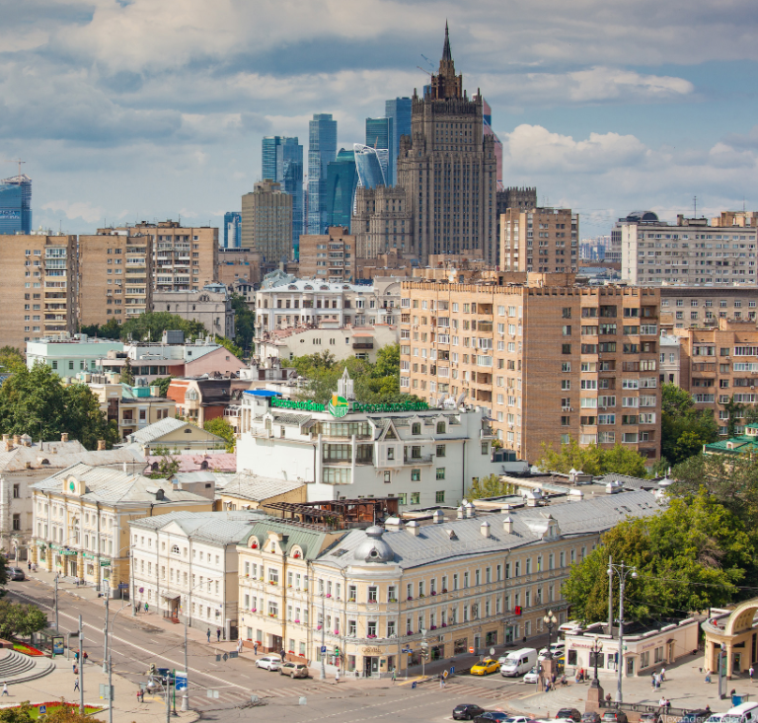
Short Recap of Moscow Khamovniki District
The district extends from Bolshoy Kamenny Bridge into the Luzhniki bend of Moskva River.
Northern boundary connects with main streets and central part of the city.
The district contains important touristic places - Pushkin Museum, Cathedral of Christ the Saviour, Novodevichy Convent and memorial cemetery, Luzhniki Stadium.
The stretch of Khamovniki between Boulevard Ring and Garden Ring, known as Golden Mile, is downtown Moscow's most expensive housing area.

Slide 4
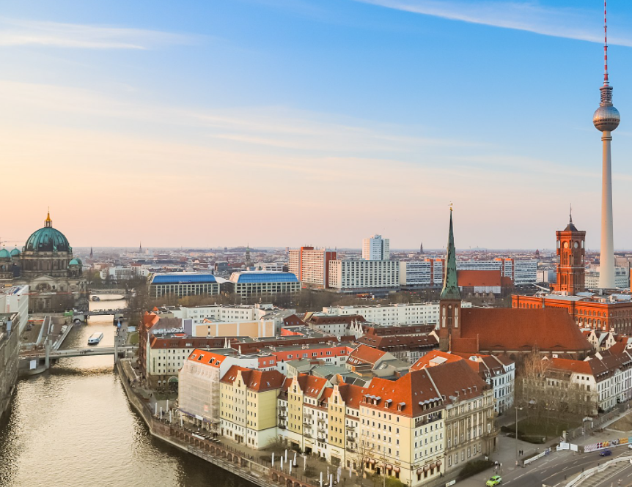
Short Recap of Berlin
Berlin is the capital and largest city of Germany by both area and population.
Berlin straddles the banks of the River Spree, which flows into the River Havel in the western borough of Spandau.
Berlin’s boroughs include old industrial areas that have become thriving cultural centres, as well as sleepy villages, busy markets and arcades, and endless green landscapes, rivers and bathing lakes.
Above all there are 12 districts and 95 neighborhoods that we can suggest to our customer.

Slide 5
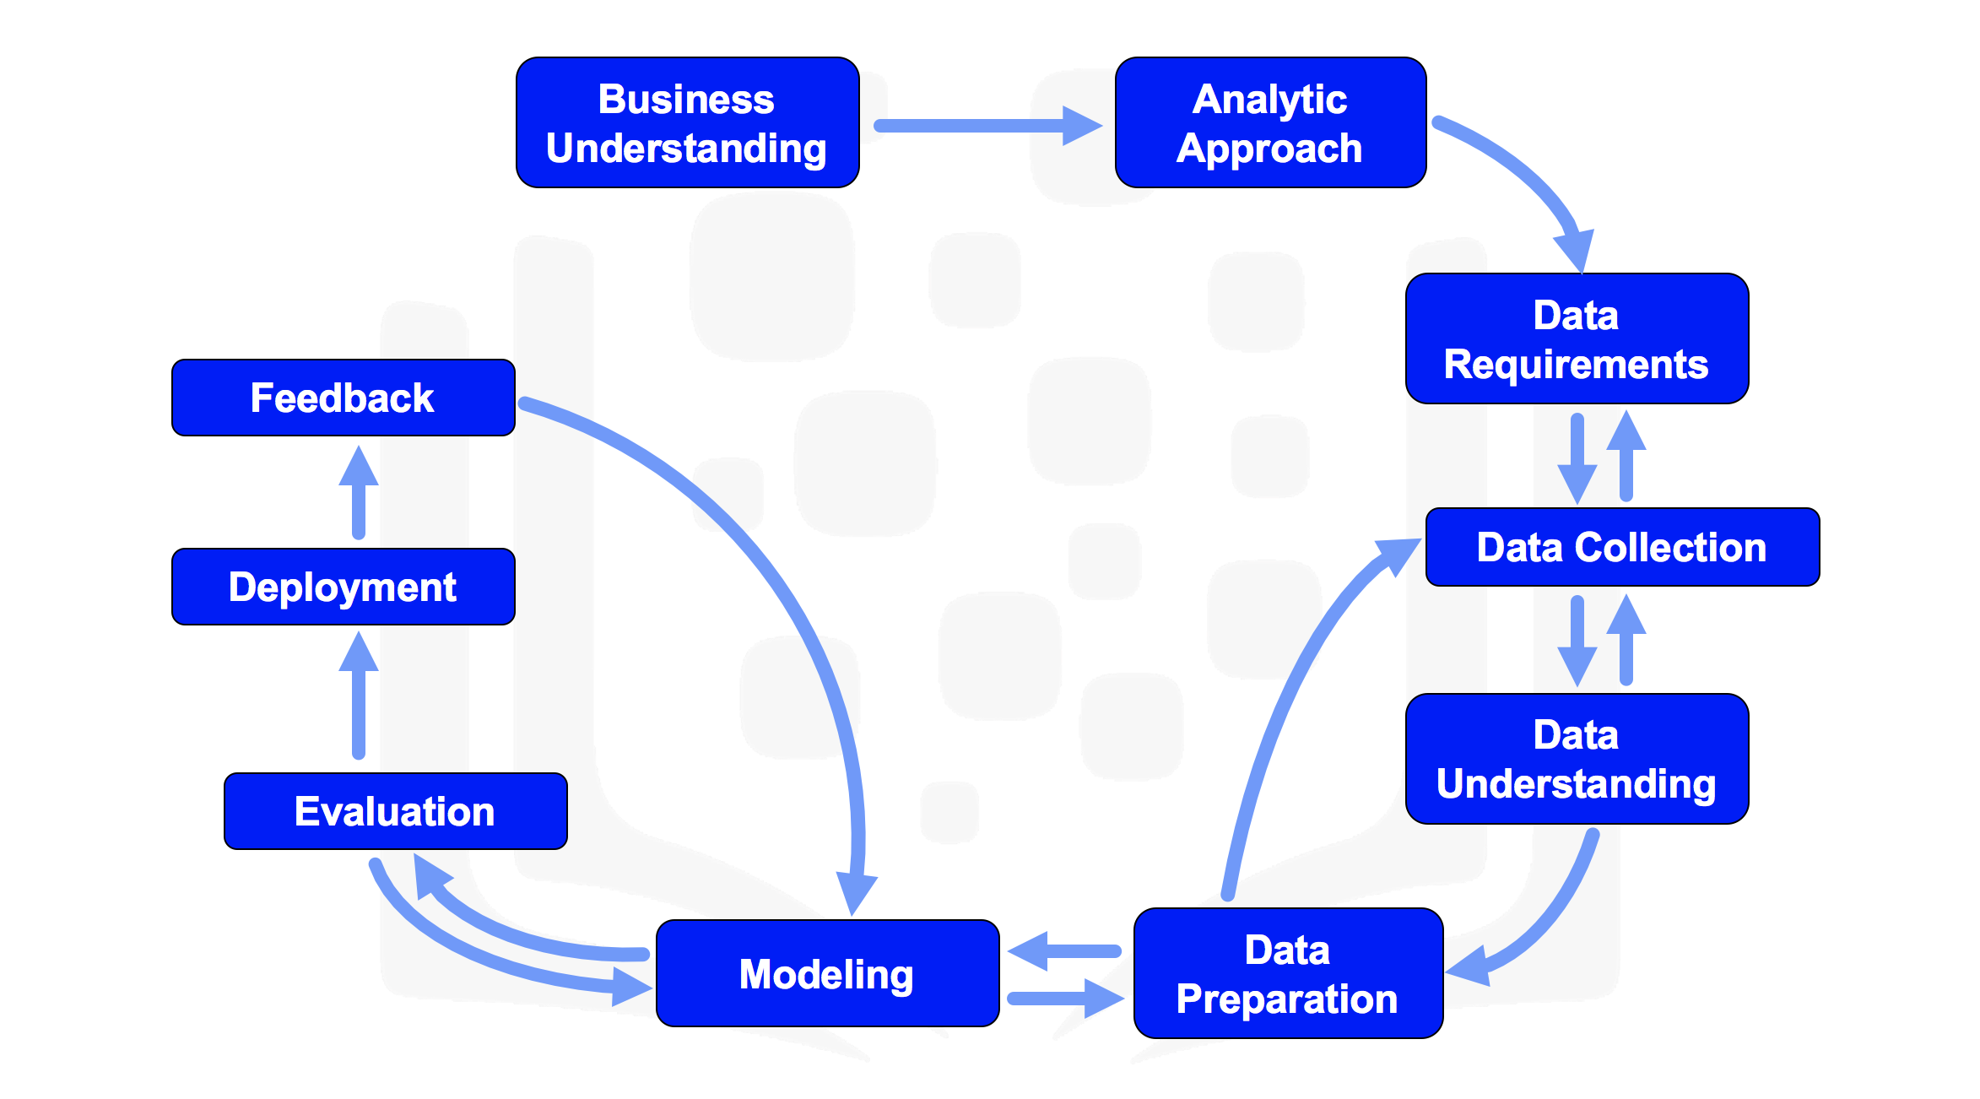
Data Science Methodology Steps
In this project, I followed the above schema on every step.

Slide 6
Discussion of the background
Analytic Approach
How it should be
Limitations
Solving this task should be considered such features:
Venue categories
Venue ratings
Venue price levels
Venue distances
House prices
Venue distances should be calculated from particular houses, chosen by client. In Khamovniki and Berlin neighborhoods accordingly.
Free version of Foursquare API allows to take only venue categories and coordinates.Having more data project can be updated using same model.
There is no choice made by client about particular places, so all distances are calculated from center locations of neighborhoods.
In this project, you can change original neighborhood to any other all over the world, but you can’t change target city, it will always be Berlin.

Slide 7



Description of the Data
Data Collection-Understanding
Foursquare API, data taken as JSON files.
Pandas library, used to turn files into data frames.
These data frames include:
Venues types
Distances of venues
Longitudes and latitudes
Names
Neighborhoods
Boroughs
Addresses

Slide 8
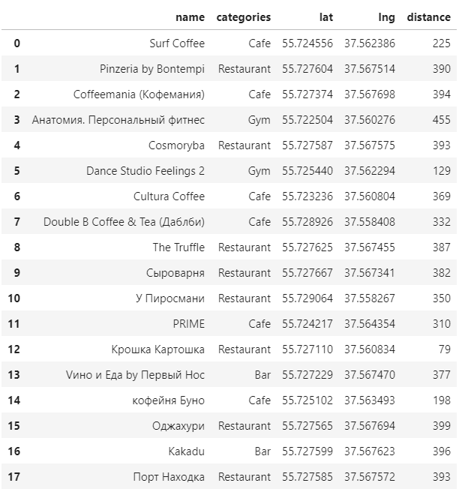
Methodology
01
Data Preparation
Our customer is focused on spesifict venue categories, such as:
Restaurant
Cafe
Bar
Gym
Data are cleaned from other venue categories and sub categories are aggregated to main ones.

Slide 9
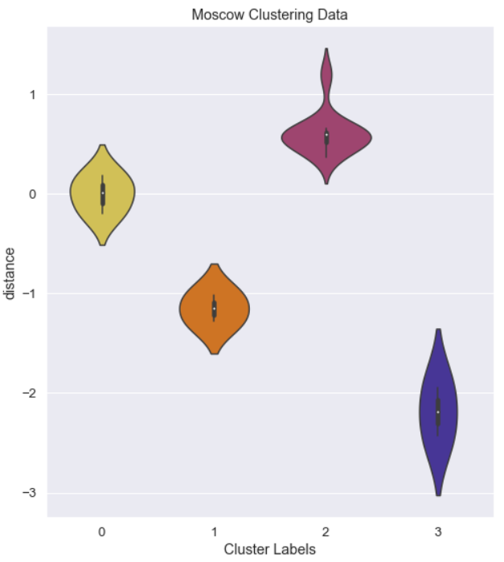
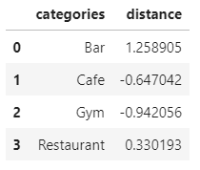
02
Feature Engineering
03
Modelling
I created new features for clarifying weights of the venue categories
Weights are calculated based on distance of all the venues in this category from the center of the neighborhood.
I used K-Means clustering to form clusters of venues considering their distances.

Slide 10
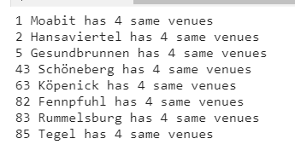
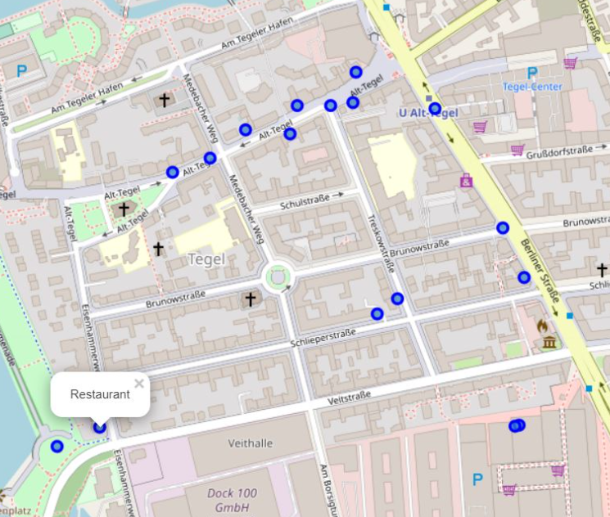
03
Modelling
I searched same neighborhoods in Berlin neighborhoods with the help of K-Means clustering.
Collecting latitudes and longtitudes of each neighborhood of Berlin
Collecting json files for each neighborhoods
Calculating weights of venue categories for Berlin neighborhoods
Comparing every neigborhood with Moscow Khamovniki District
Finding the one with closest weights.

Slide 11
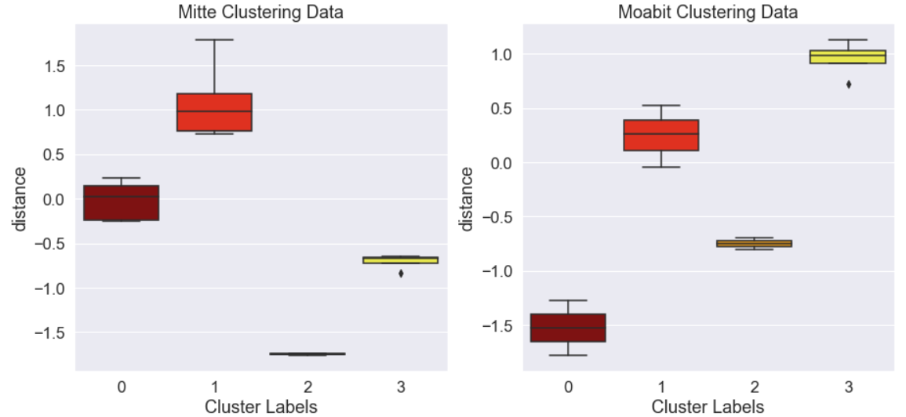
04
Evaluation
I have found 8 neighborhoods with the same amount of all venue categories.
To choose perfect one, I observed how possible neighborhoods match with customer's neighborhood with K-Means clustering.
I observed K-means clustered plots and minimum mean distance value from neighborhood center. Because in our case, our customer haven’t chosen any particular house in Berlin yet.
Using this data I have found a neighborhood with the minumum mean distance of all the venues comparing to other neighborhoods.
At 4th March 2021 such result shows Mitte neighborhood of Berlin.

Slide 12
05
Result - Conclusion
Considering number of venue in different categories and their distances from center of neighborhood best closest choice for moving from Khamovniki to Berlin is Mitte (as of 4th March 2021)
During the time, collecting new data this result can change.
In this project, you can change original neighborhood to any other all over the world, but you can’t change target city, it will always be Berlin.

Slide 13
Thank you for your time

